Slide 1
FERTILIZER SPRAYING ROBOT

Slide 2
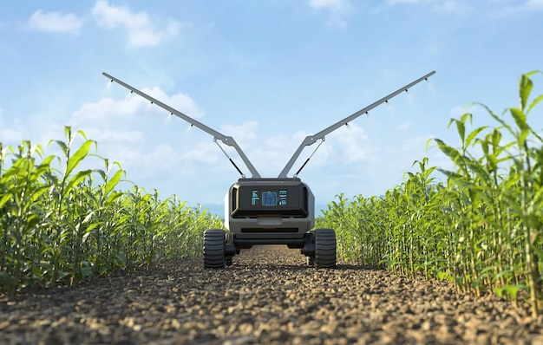
Group
Members
GAHDSE241F-044 Ranasingha A.S GAHDSE241F-045 C.D.Wijesekara
GAHDSE241F-046 J.K.N.T.Dilshan

Slide 3
Contents
Introduction
Demonstration
Problem and solution
Advice for future researchers Future implementations

Slide 4

Introduction
There is no improvement in the agricultural sector of our country. Thus, traditional methods of applying fertilizers cause damage to plants and waste fertilizers. And it causes a lot of environmental damage and also increases the cost of the farmers. The fertilizer spraying robot has been designed to meet these challenges.

Slide 5
Demonstration

Slide 6
Problem And Solution
Sometimes, some jump wires not work – Checking the jump wires one by one
One mistake in coding can cause the code to stop working – Checking the code rules one by one
Difficulty using the pump controller – Using servo motor instead of pump controller
All three Arduino Uno boards that we used are out of order – Getting the right board for the lecturer
Robot’s wheels not working – Trying to fix the coding

Slide 7
Advice for future researchers
Making parts coded separately.
Accept the project by thinking before whether things related to the project are possible or not.
Divide the project into parts and find out about it.
Look for similarities in several research papers.
Manage time properly
Find the weaknesses and challenges encountered by previous researchers.
Work according to the data in the research papers.

Slide 8
Future implementations
Design a robot that can travel anywhere.
Expand the project with IOT.
Using solar panels instead of batteries.
Make the robot more resistant to weather changes.
Use WIFI / Bluetooth to enhance the performance

Slide 9
Q & A
Q&A

Slide 10
Thank you!
Thank You

